Slide 1

E 121
Team O-4 Robot
Julia Selleck
Sarah Haley
Jonathan Joshua
Abdullah Hyder

Slide 2
Objectives
Create a clear program that can efficiently react to obstacles
Design bumpers and a platform that can respond to collisions
Manage and wire the light sensors to respond to light change

Slide 3
Mechanical Design - Body
Wood
Sturdy for competition obstacles
Efficient to work with during construction
Appealing for visualization
Platform and sides-
Cover the wiring of the robot
Protect robot without too much weight
Logo - Flame
Symbolism of Fire
Creation
Destruction

Slide 4
Mechanical Design - Bumpers
Slot Mechanism - allows for head-on collisions
2 Bumpers-allows for more sensitivity to collisions
Code - clear functions and return statements
Material - Acrylic
Reduces friction for high sensitivity
Obstacle:
Bumpers rotated 360 degrees and would not stay in place
Solution: attach a string from the back of each bumper to the back of the robot to hold the bumpers in place

Slide 5
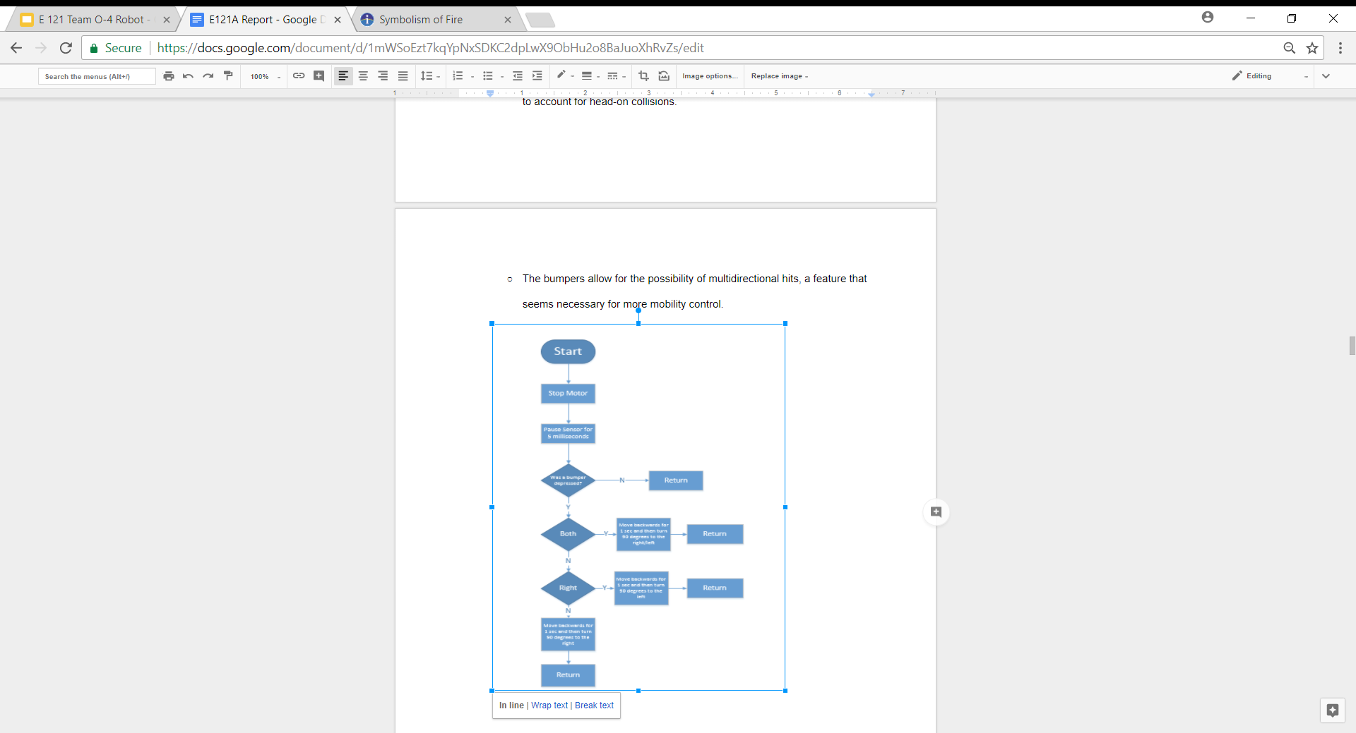
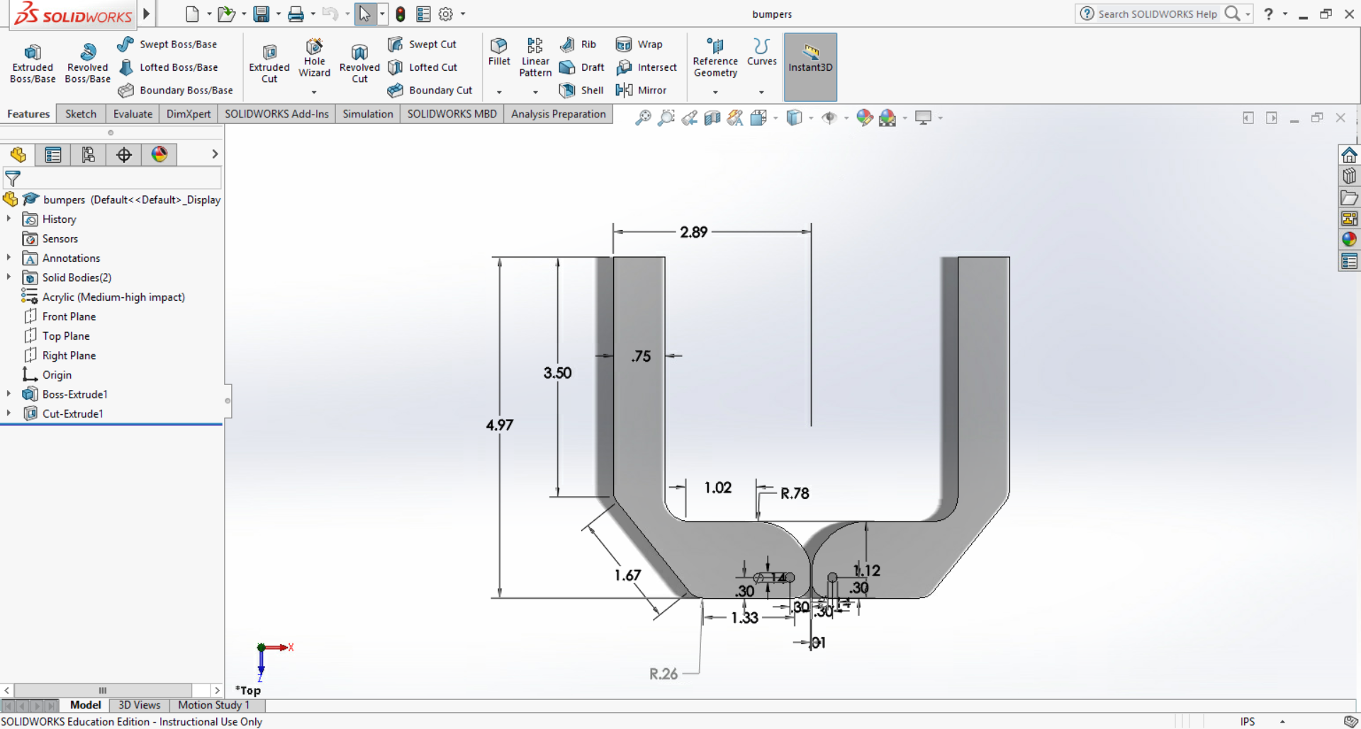

Slide 6
Mechanical Design - Light Sensors
5 Light Sensors
3 on the front/sides - range of motion to follow front targets on side and center
1 on the top - to follow upward light targets
1 on the bottom (LSM) - to react to floor color change at the halfway mark
Sits inside boxes to focus the light sensors on heavy light concentration

Slide 7
Programming Design
The robot rotates until the top sensor has a lower reading than the previous reading so that the robot is facing the other side
The program constantly tests the floor color
The left and right sensors are compared to determine the direction to turn in
The robot moves forward in small increments until the light is hit
The robot checks if it is on the wrong side

Slide 8
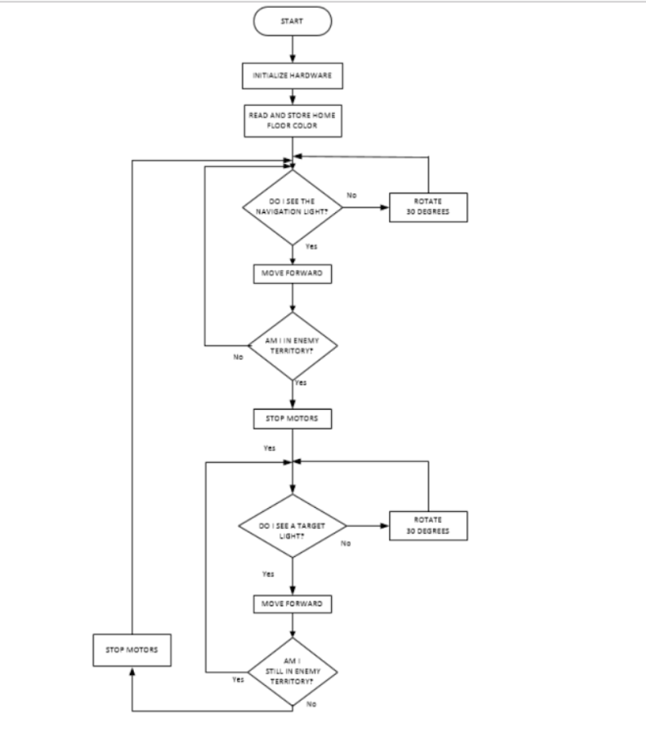

Slide 9
Electrical Design
Light sensors are put in order from A0 to A4 starting from the floor sensor to the left bottom sensor to the top sensor
Bumper sensors are put on the right and left D3 and D2 ports
The wires are placed in areas that are still accessible after the housing is secured

Slide 10
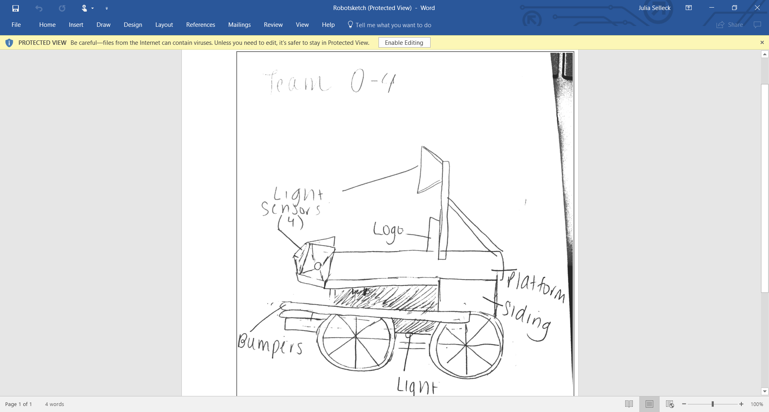
Conclusion
This project improved teamwork and leadership skills.
This project challenged us to discover and expand our software and hardware skills
Design was constantly changing because of obstacles or new ideas created during the construction process.

